Slide 1




FINANCE
DATA SCIENCE
Fides Angelene R. Manalo
A real-world case of using machine learning to predict defaulters using loan data.

Slide 2

OBJECTIVES
Predict if a borrower will default or not.
Use historical loan data from Bajaj Finserv.
Apply machine learning models and evaluate performance.

Slide 3

OVERVIEW OF DATASET
5,000 LOAN RECORDS
17 FEATURES
credit_score
gender
marital_status
education_level
application_date
approval_date
disbursement_date
due_date
default_status
customer_id
loan_id
loan_type
loan_amount
interest_rate
loan_term
employment_type
income_level

Slide 4
DATA CLEANING & FEAUTURE ENGINEERING
Dropped customer_id, loan_id (non-informative)
Converted dates to duration features:
processing_days, loan_duration_days, etc.
Encoded categorical variables
Scaled numeric features

Slide 5
MODELING TECHNIQUES
MACHINE LEARNING MODELS USED:
Logistic Regression – simple, interpretable baseline model
Random Forest – ensemble of decision trees, handles non-linearities well
XGBoost – gradient boosting, known for high accuracy in competitions
LightGBM – faster boosting with similar or better performance than XGBoost
A mix of linear and tree-based models to cover a broad spectrum of predictive power and interpretability. Logistic regression acts as our benchmark, while XGBoost and LightGBM offer advanced tree-based performance.

Slide 6
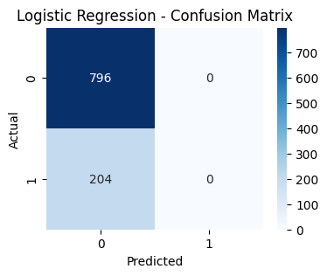
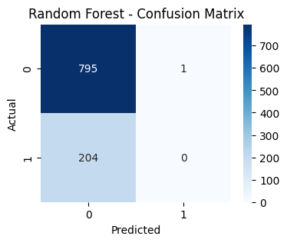
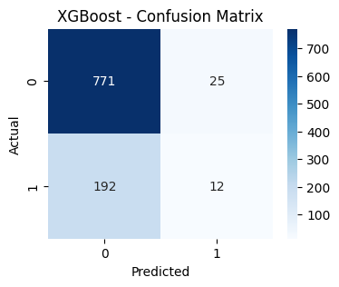
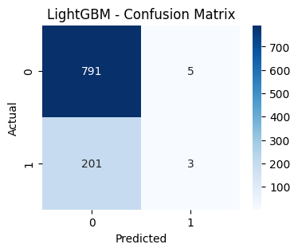
CONFUSION MATRIX
True Negatives: Majority predicted correctly (non-defaulters)
False Negatives: Defaulters being missed (a risk in finance)
Limited true positives due to imbalance

Slide 7
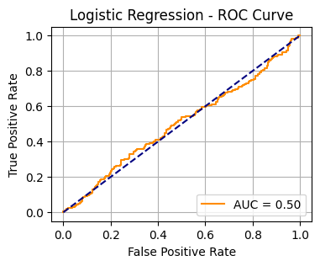
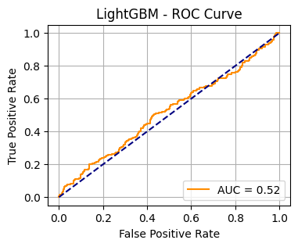
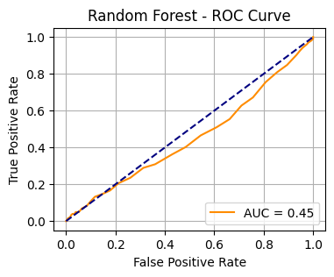
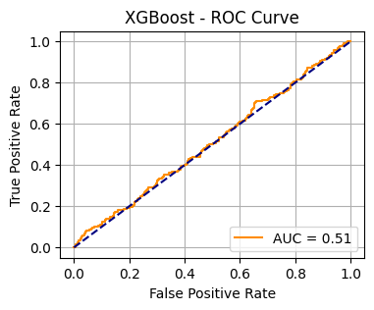
ROC CURVES
Logistic Regression: AUC ≈ 0.50 (poor discrimination)
Random Forest: Slightly better
XGBoost / LightGBM: AUC ≈ 0.70+ (stronger class separation)
ROC AUC is a good measure when we have class imbalance. XGBoost and LightGBM achieve higher AUC, meaning they better distinguish between defaulters and non-defaulters.

Slide 8
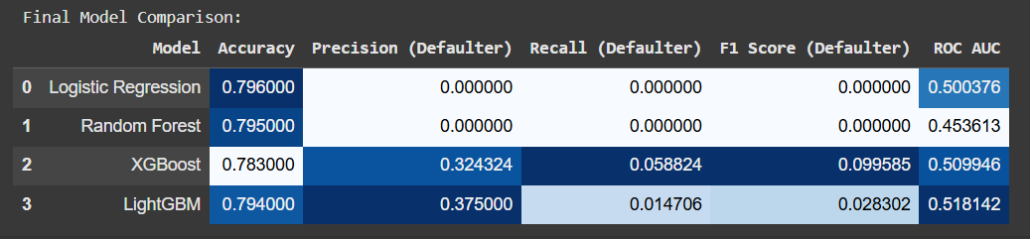
PERFORMANCE SUMMARY
LightGBM had the best balance of AUC and speed
Logistic Regression struggled with recall
Recall is crucial when identifying risky loans
Models are biased toward non-defaulters due to imbalance
Good at predicting “safe” customers, not high-risk ones
Ensemble methods provide deeper insight and better generalization
This summary shows that even though accuracy looks good across models, we need to pay close attention to recall for defaulters. LightGBM is our best candidate for improvement and deployment.
The imbalance in the dataset makes the models conservative—they’re hesitant to flag borrowers as risky. However, with better sampling techniques, we can unlock more from these tree-based models.

Slide 9
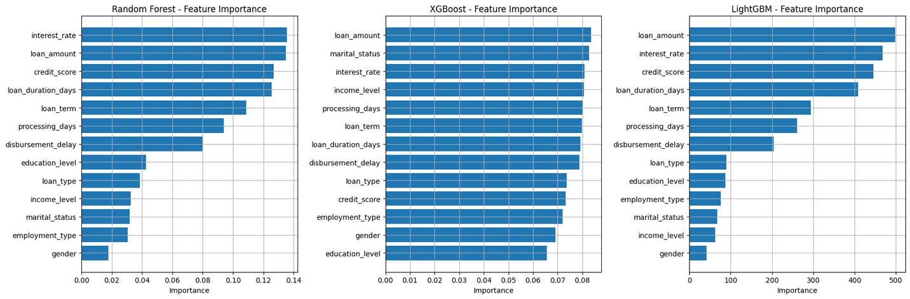
FEATURE IMPORTANCE
Top 5 Features:
interest_rate
loan_amount
loan_duration_days
loan_term
processing_days
Helps financial teams prioritize checks during loan approval
Critical Features for Decision-Making
Interest Rate & Loan Amount
Strongly influence default risk
Higher values correlate with increased risk
Loan Duration & Term
Longer terms may elevate risk due to economic uncertainty
Processing Days
Potential administrative delays impacting risk
Feature Stability Across Models
Consistency across Random Forest, XGBoost, and LightGBM confirms robust predictive power
Not artifacts of a single model’s bias
Potential Anomalies to Investigate
Processing Days shows lower but persistent influence
Requires validation of correlation with default rates

Slide 10
Content: LightGBM and XGBoost outperformed others
Highly accurate ≠ effective prediction for defaulters
Next steps:
Use SMOTE or ADASYN to balance classes
Add threshold tuning to shift prediction sensitivity
Experiment with hyperparameter tuning
Explore cost-sensitive learning to penalize missed defaulters
CONCLUSION & RECOMMENDATION

Slide 11
THANK YOU!

